Slide 1

To what extent do the use of Artificial Intelligence systems in Medicine contribute to the socio-economic condition of society?
An Extended Project by Philip Mortimer

Slide 2


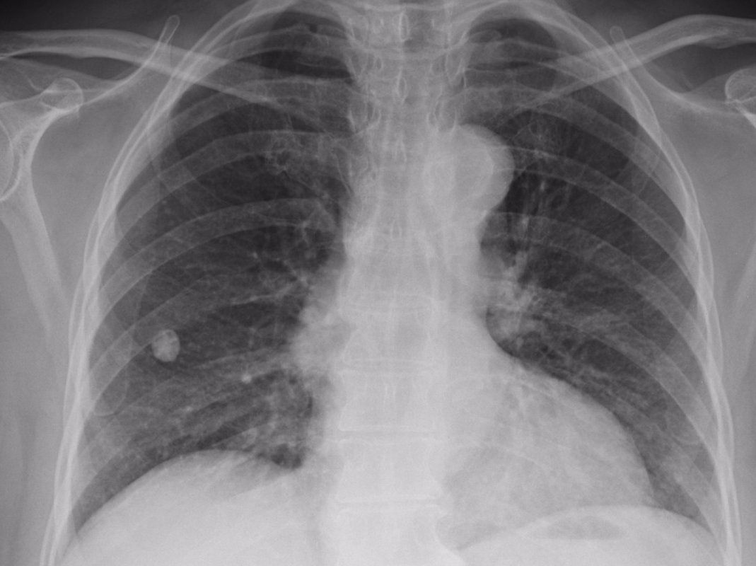
Part One – Dissertation Outcome

Slide 3

To what extent do the use of Artificial Intelligence systems in Medicine contribute to the socio-economic condition of society?
Artificial Intelligence (AI) – computer systems that perform tasks as well as humans.
My dissertation focuses on the overall social and economic impact of AI systems in healthcare.
Medical AI can be divided into two categories: systems that are in the research phase and systems that are currently used by medical professionals.

Slide 4
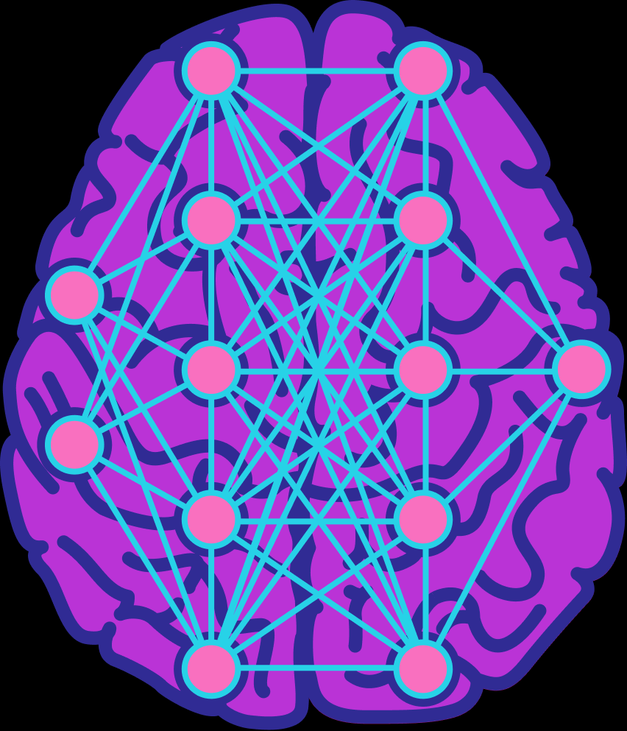
Strengths and Weaknesses of AI
Machine learning systems find underlying patterns in data.
AI is effective at image analysis.
AI systems are limited by the accuracy, quality and size of data provided. This can lead to unintended biases.

Slide 5
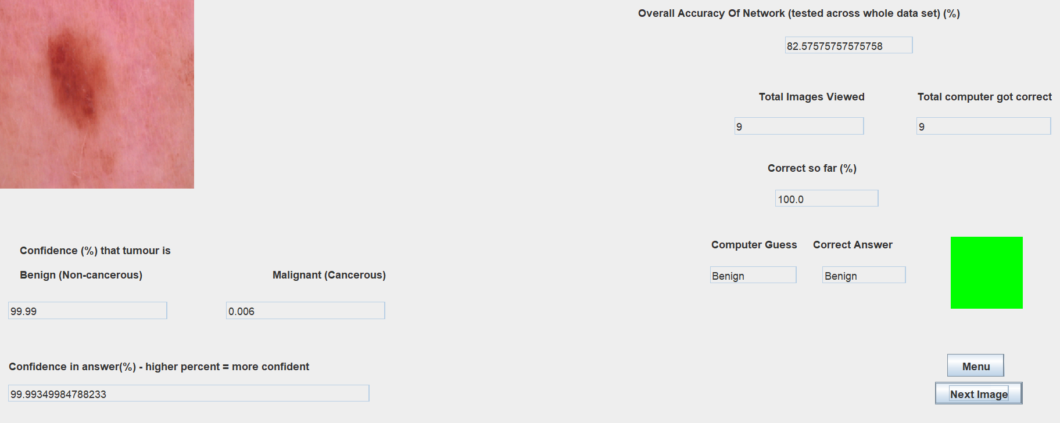
Example
My model was trained on 2000 images of pigmented lesions.
Outperforms dermatologists at skin cancer detection.
Model will perform worse on people of colour.
Try it - https://github.com/PhilipMortimer100/Tumour-Classification-Using-Machine-Learning

Slide 6
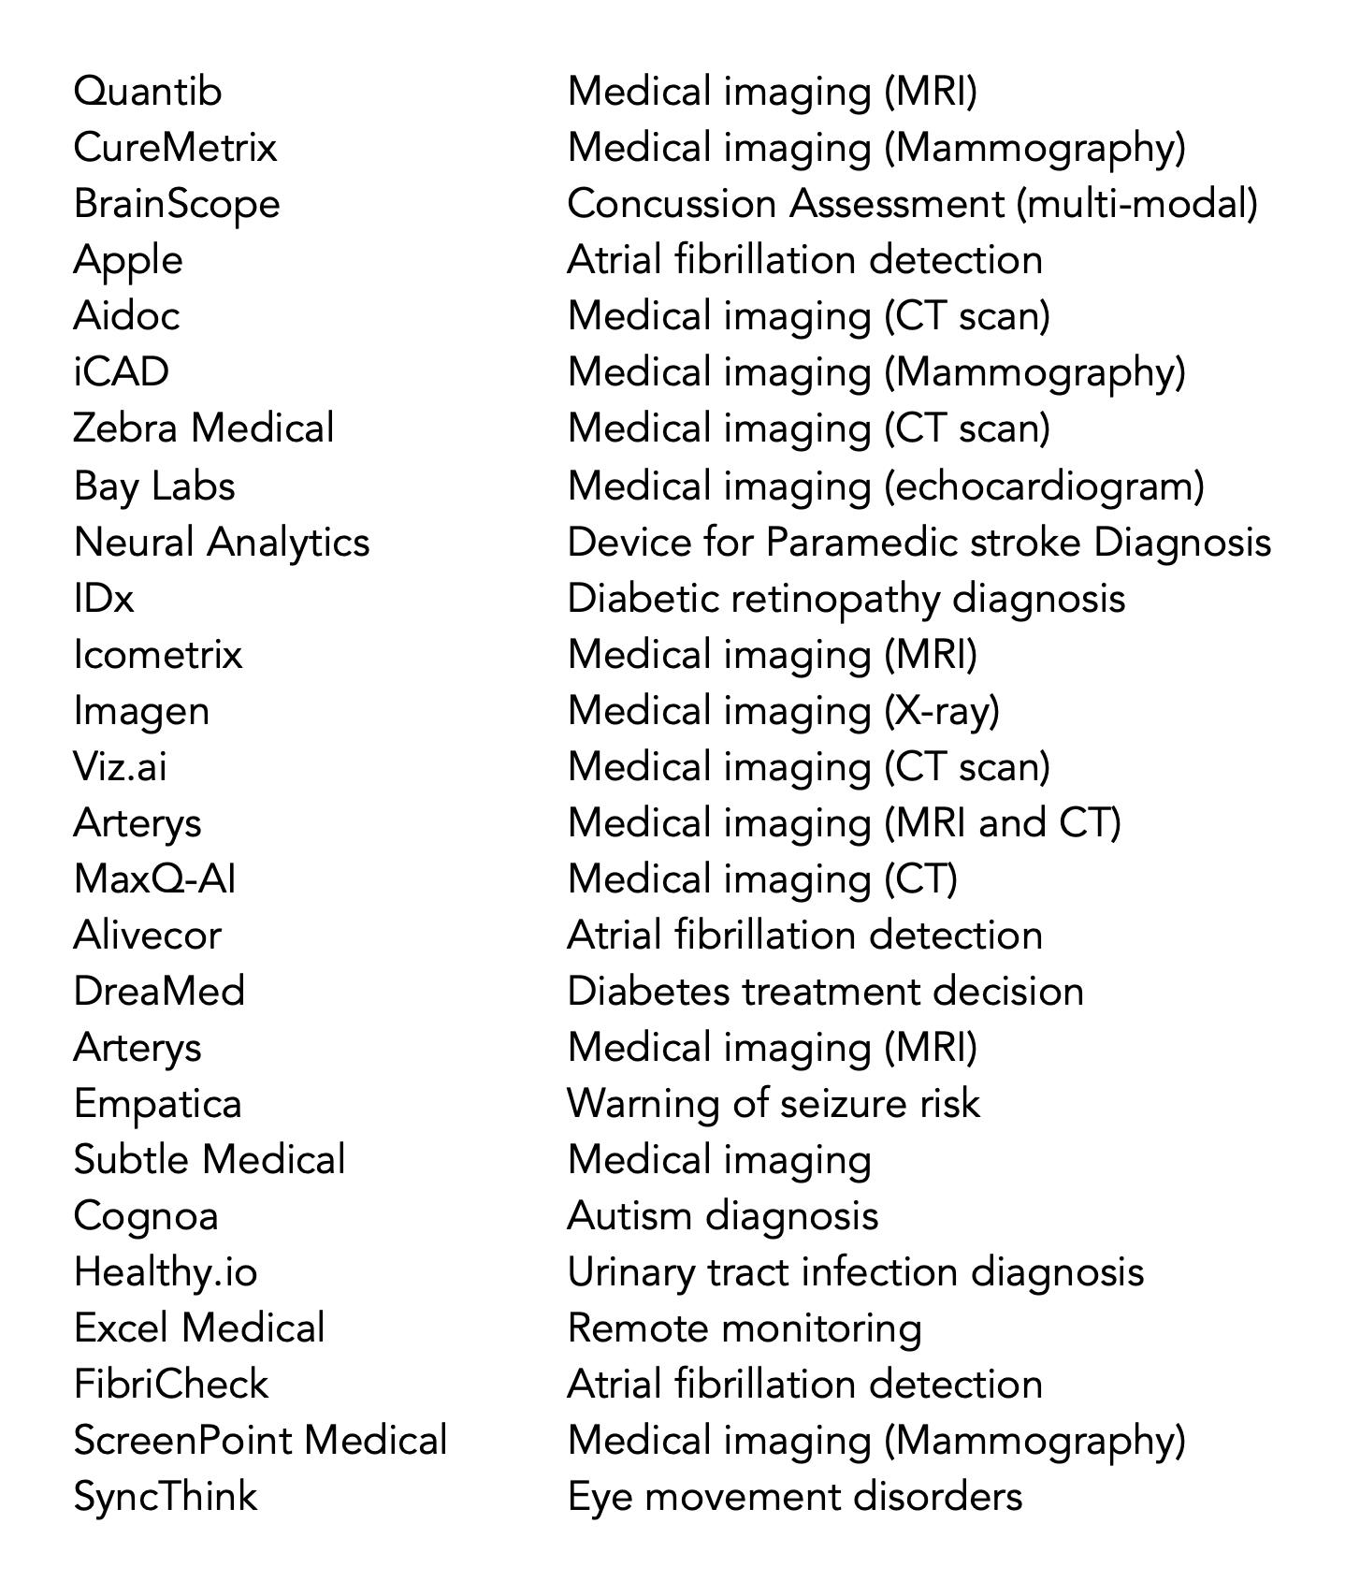
Prevalence of Medical AI
There is lots of research into Medical AI, but little implementation.
26 approved AI systems.
Roughly half of these systems are used in medical imaging.

Slide 7
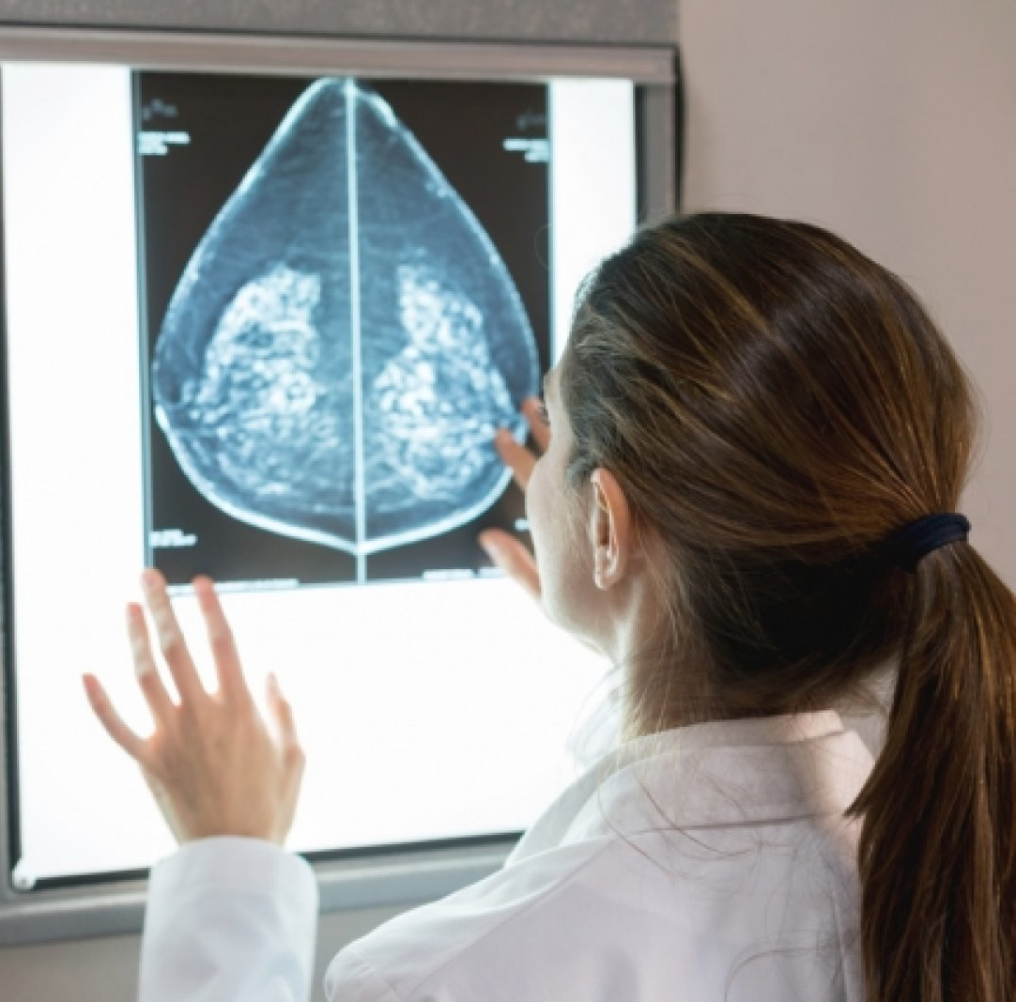
Research into Medical AI

Slide 8
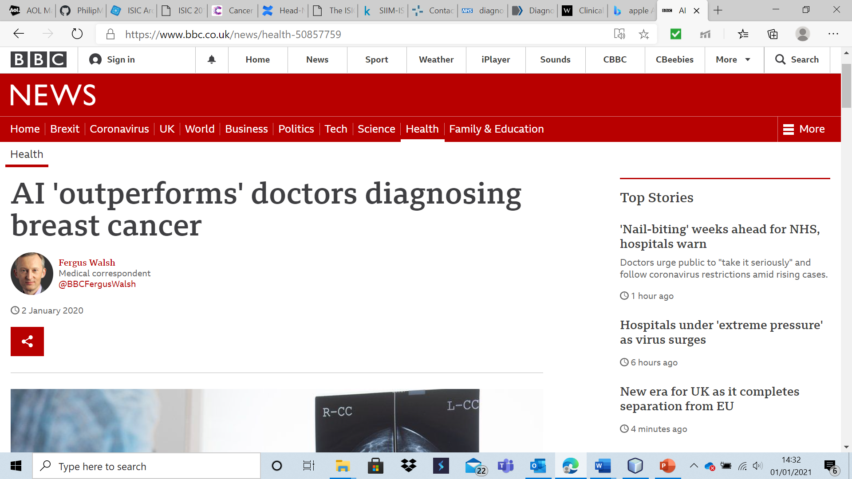
Breast Cancer Diagnosis System
Trained on 29,000 mammograms (an X-Ray image of the breast).
Had 1.2% fewer false positives and 2.7% fewer false negatives than British radiologists.
This AI system performed as effectively as two radiologists combined.

Slide 9
Socio–Economic Impact of System
Potential to save many lives.
AI doesn’t get tired – more consistent analysis.
Would address shortage in radiologists.
Research like this will lead to accurate AI systems being used widely in healthcare in the future.
Ethical concerns about access to sensitive health data. Can be addressed by anonymisation.
This system has not been implemented yet.
Research is expensive.
This system is similar to other systems currently being researched.

Slide 10
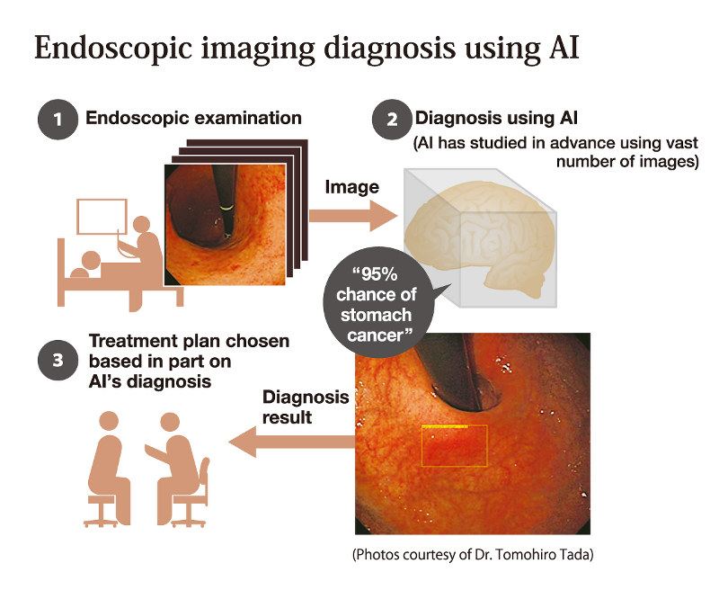
AI Systems Currently in Use
Low number of AI systems currently in use.
To assess the overall impact, I decided to focus on a typical system.
This approach was justified as the number of systems in use is low and as these systems are all similar in impact.

Slide 11

Atrial Fibrillation Detection
Atrial Fibrillation (AF) is a common heart condition that affects 5 million people in the USA.
Around 13% of cases are undetected.
Undiagnosed AF suffers have a very high stroke risk.
Undiagnosed AF costs $3.1 billion in additional healthcare expenditure in the USA.

Slide 12
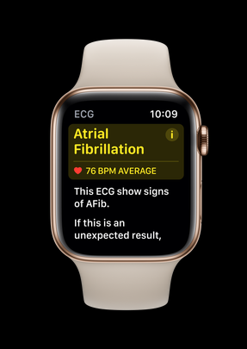
Atrial Fibrillation Detection Using the Apple Watch
70 million Apple Watch Sales.
The Apple Watch has an electrocardiogram.
10,000 AF patients were used to train an AF diagnosis system for the watch.
This system was approved by the FDA and is now a selling point of the device.

Slide 13
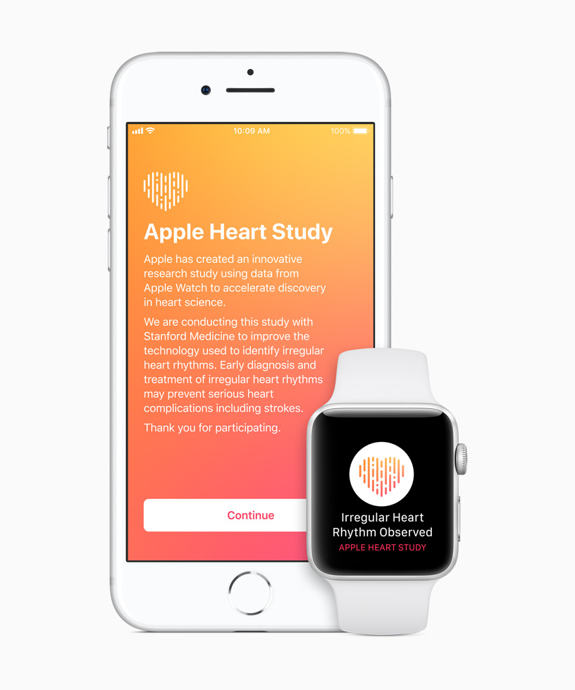
The Apple Heart Study
The Apple Heart Study - a study consisting of 420,000 people.
The system had a positive predictive value of 71% (i.e. 71% of positive tests were confirmed to be correct)
77% of expected AF cases were identified – a really positive result.
The study showed that the Apple Watch was effective at identifying AF.

Slide 14

Socio-Economic Implications of Apple Heart Study
On average, each Apple Watch sold saves $7.83 in healthcare expenditure in the USA. Applied to the 70 millions sales so far, the Apple Watch has the potential to save $550,000,000.
This number is only a rough estimate.
The massive economic benefit of this AI system is self-evident.

Slide 15
Socio-Economic Implications of Apple Heart Study
AF screening can be rolled out to a large group of people.
Enhances the quality of and save many lives.
Millions of dollars will be saved – due to reduction in healthcare expenditure and a longer and healthier life.
The promise of the technology will lead to development of other effective systems in AF and other areas.
The Apple Watch costs about £200, making it unsuitable to solely use as an AF monitoring device.

Slide 16

Conclusion
Both research into medical AI and actual use of medical AI have an overall positive socio-economic impact.
I conclude that the impact of each individual approved system is very positive, but that the overall current socio-economic impact of AI in Medicine is quite positive.
The biggest limiting factor is that so few systems have been approved.

Slide 17
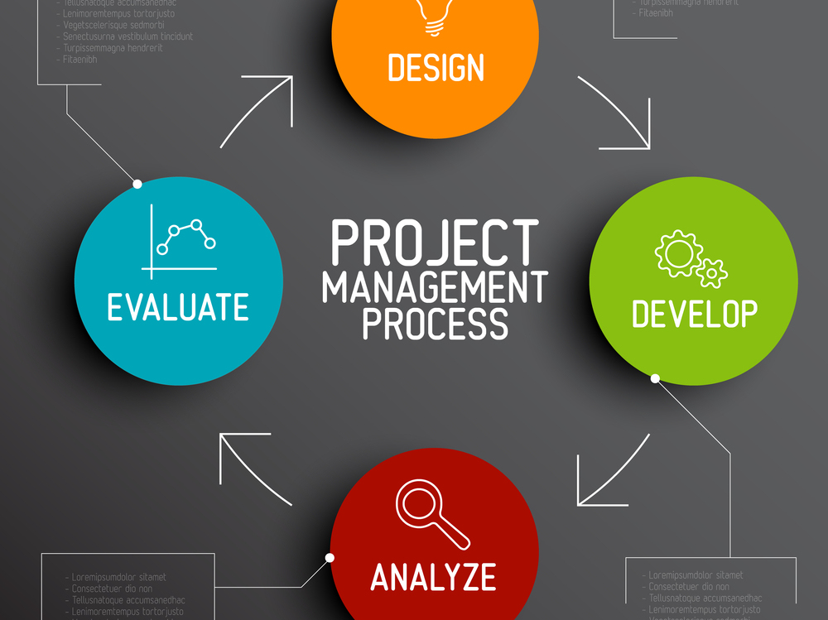
Part Two – Project Process

Slide 18
How I Chose my Dissertation Title
I considered six general topic areas.
I choose to assess at the potential future developments of AI given its current uses.
I redrafted my question multiple times. I changed the focus to current applications.
When writing, I narrowed the scope further to only focus on AI in healthcare.
My actual question: “To what extent do the use of Artificial Intelligence systems in Medicine contribute to the socio-economic condition of society?”

Slide 19
My Aims And Objectives and reflection
Aim 1- To thoroughly assess the extent that Artificial Intelligence systems in Medicine contribute to the socio-economic condition of society
Objective 1.1 To clearly set out what Artificial Intelligence systems are.
Objective 1.2 To present the uses of these systems and explain how they contribute to the socio-economic condition of society.
Objective 1.3 To outline the different viewpoints of people in regard to the extent that these systems contribute to (or detract from) society, highlighting where there is general consensus and where controversy exists.
Objective 1.4 To take into account all views to reach a well-informed conclusion as to the impact of medical AI systems on society and whether it`s generally a positive or negative one.
Aim 2 -To thoroughly explore many sources on my research topic
Objective 2.1 To draw from at least 100 sources on the topic of Artificial Intelligence and related areas.
Objective 2.2 To evaluate the reliability of each source in order to ensure that my piece is based on accurate information.
Objective 2.3 To analyse all kinds of resources to ensure a balance of sources, including: books, webpages, academic papers and videos/podcasts.

Slide 20
My Aims And Objectives and Reflection
Aim 3- To create a detailed plan on what I intend to do in my project
Objective 3.1 To create a detailed list of sub-questions which I wish to address in my overall dissertation
Objective 3.2 To research at least 3 time management and project plan resources and reach a conclusion as to which is the most appropriate.
Objective 3.3 To fully break my project down into all of the individual tasks that I will need to perform for my project to be successful.
Objective 3.4 To produce a time management resource that sets specific deadlines for each of the specific tasks in my project to be completed.
Aim 4- To develop the range of skills required to produce a high-quality dissertation
Objective 4.1 To acquire a high level of digital literacy to help my research topics, by making use of Boolean search terms and resources such as Google Scholar.
Objective 4.2 To practice secondary source analysis by researching analysis techniques such as “CAP”.
Objective 4.3 To research the Harvard referencing system and best referencing practices and determine which of these I will use in my project.

Slide 21
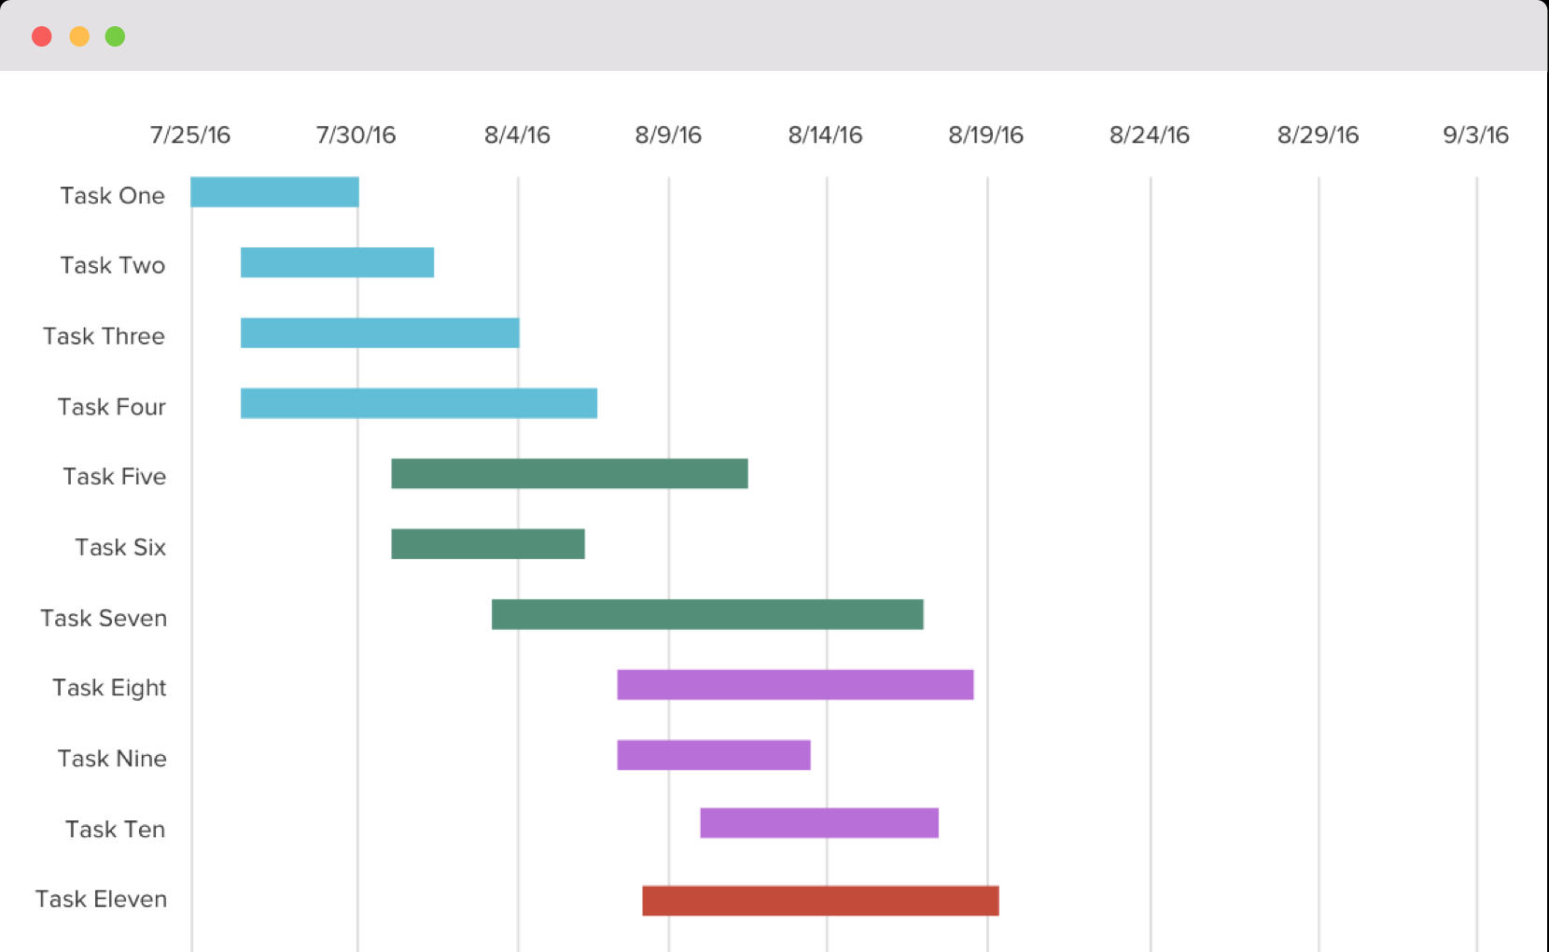
Planning Dissertation
Researched multiple planning methods and settled on using a Gantt Chart and table.
My plan was detailed but significantly altered through actually writing the dissertation.
COVID-19 meant deadlines changed significantly.
My plan was well-produced but ultimately ineffective.
I would make my plan more free-form if I had to do it again, but I also feel that no plan would have worked due to the unforeseen impact of the pandemic.

Slide 22
Problem Solving and Skill Developed
I started writing my dissertation on overall AI use and came to a point where I realised that the project would be too long. I had to decide whether I should start over with a more focused question or not – problem solving skills developed
There were lots of inaccurate and speculative resources on AI, it was difficulty to decide which resources were reliable. To do this, I researched “CAP”.
Developed time management skills.
Critical thinking skills.

Slide 23
Evaluation of Project Outcome
Overall, I am satisfied with my project as it is very thorough and comprehensive.
Used over 100 reliable resources, I feel confidently about my conclusion. I used a wide range of resources – from podcasts to academic journals.
The project process was not perfect, I would have devoted more time to research before formulating a question.

Slide 24

Q&A Session
Thank you for listening.
I will now answer any questions.

